Slide 1
Project Overview
Project start= Feb 2024
Project manager= Karolina* (gave notice of leaving at the end of Feb 2024, left end of April 2024)

Slide 2
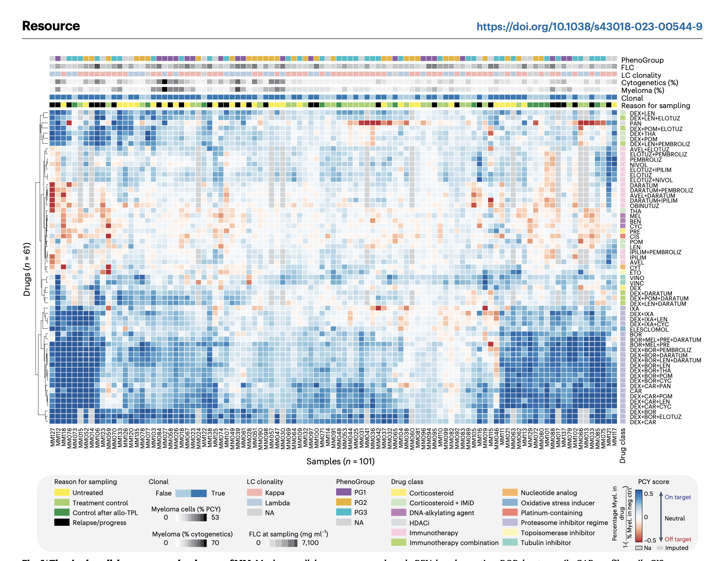
Dataset
Proteomics
Cytokines
Clinical
Survival analysis
PCY drug response

Slide 3
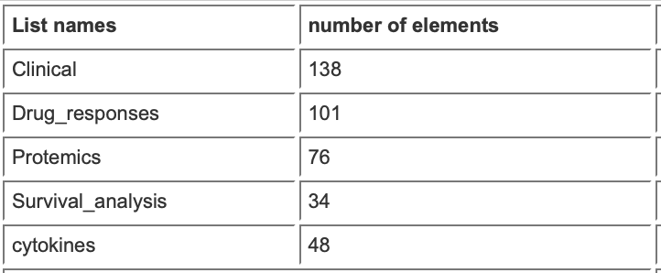
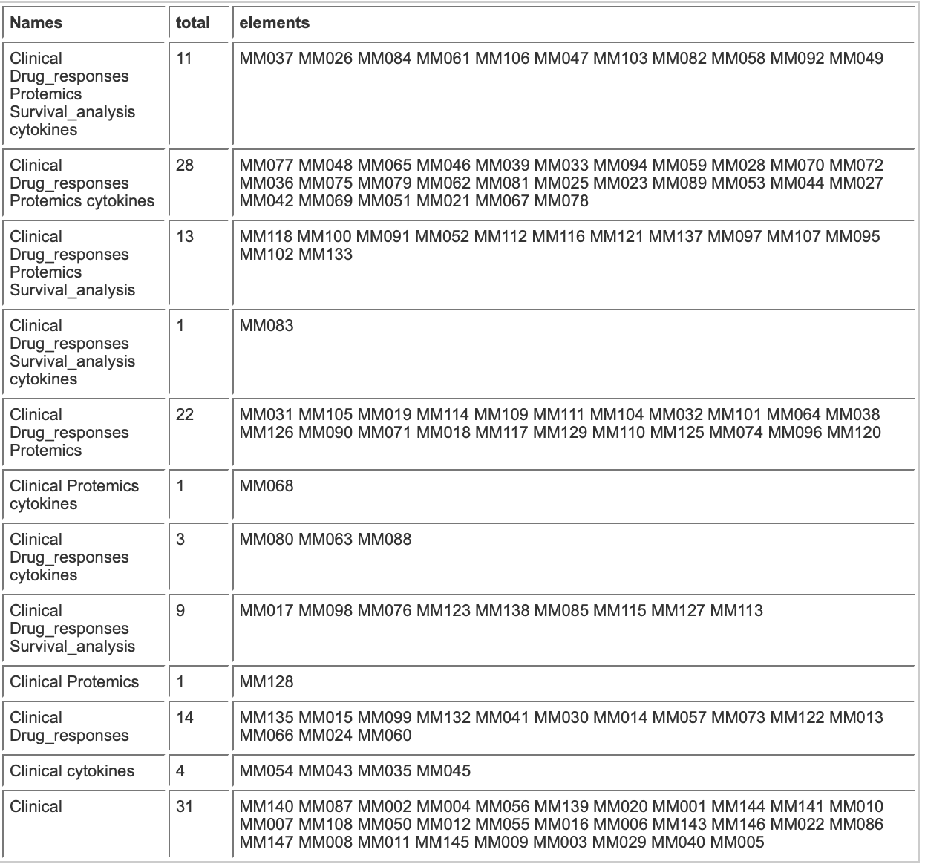
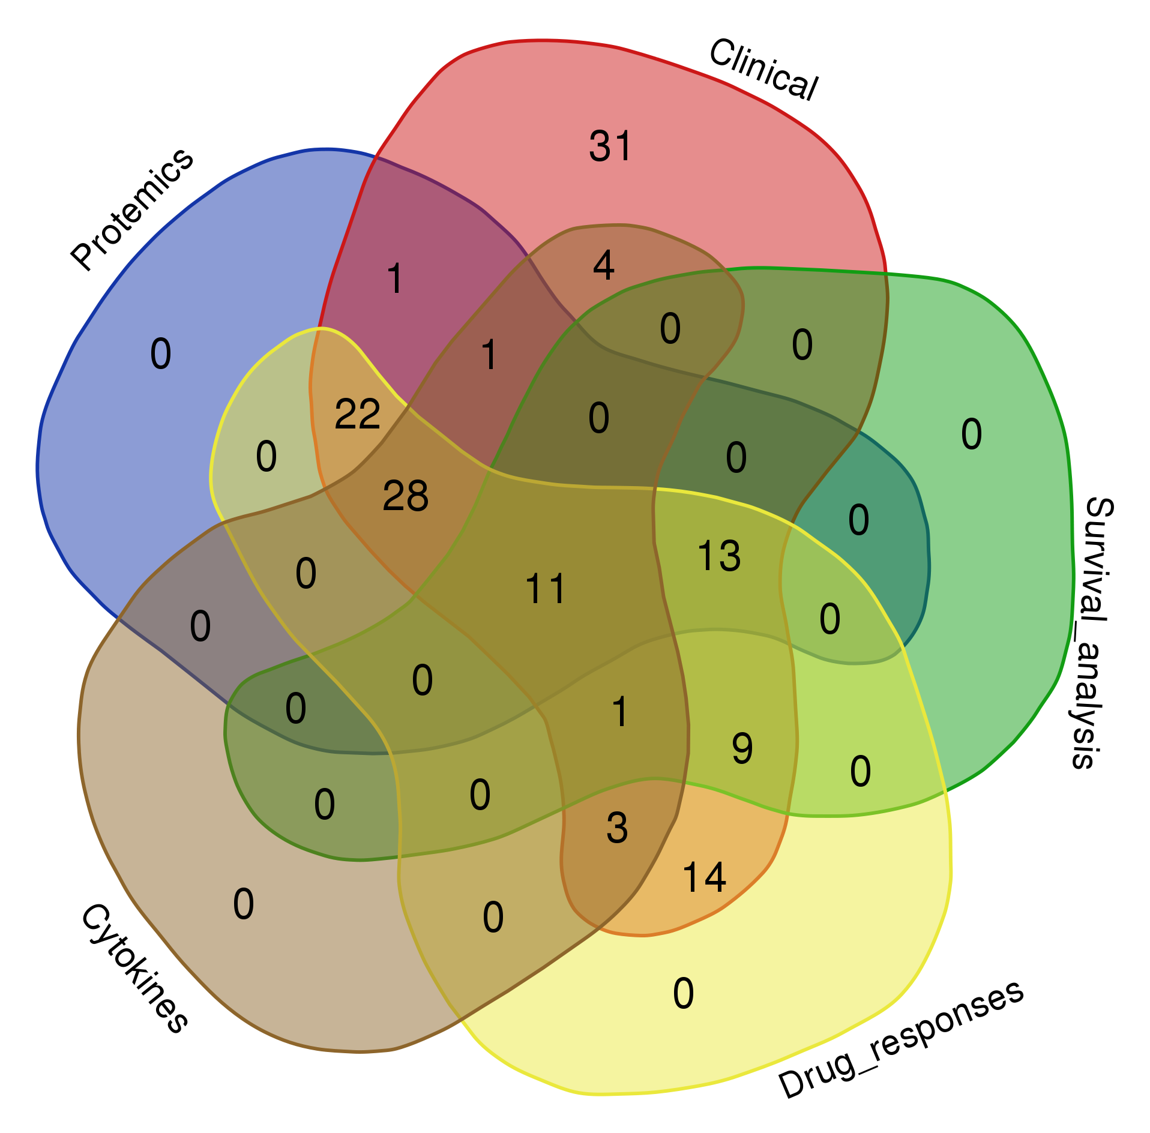

Slide 4
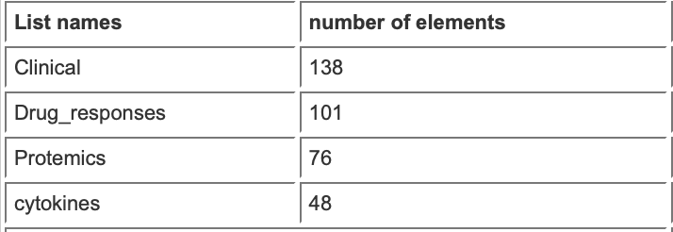
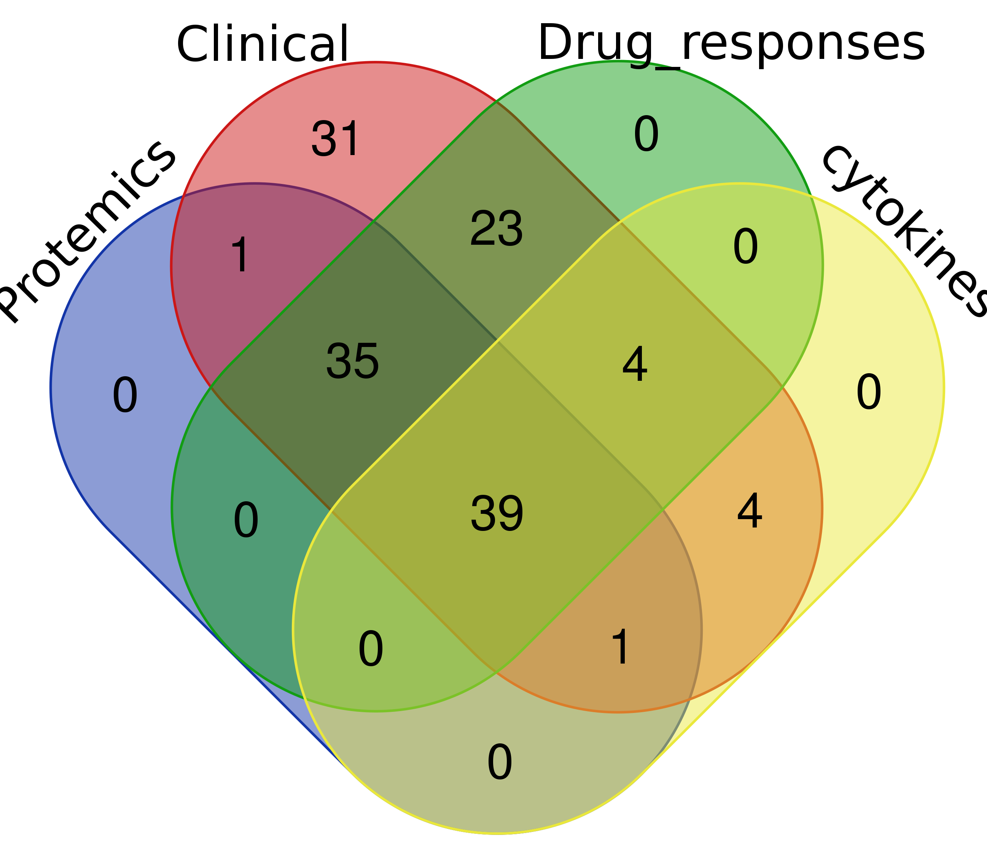
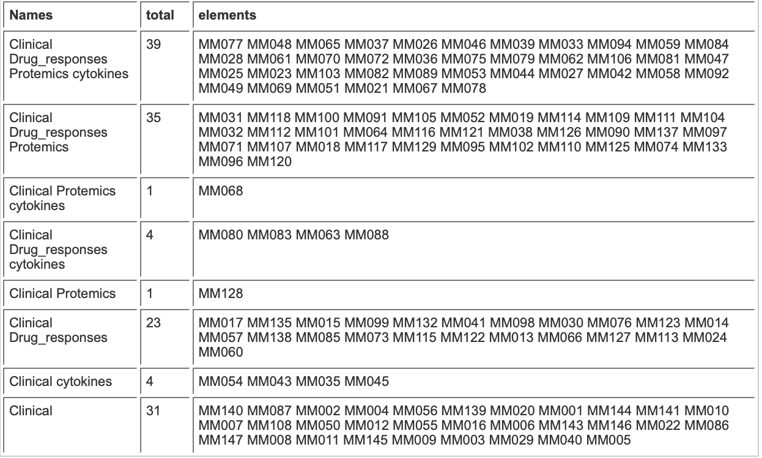

Slide 5
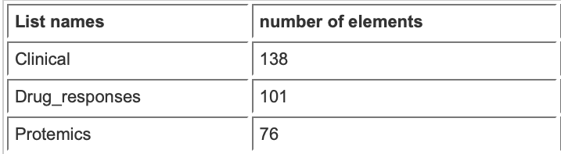
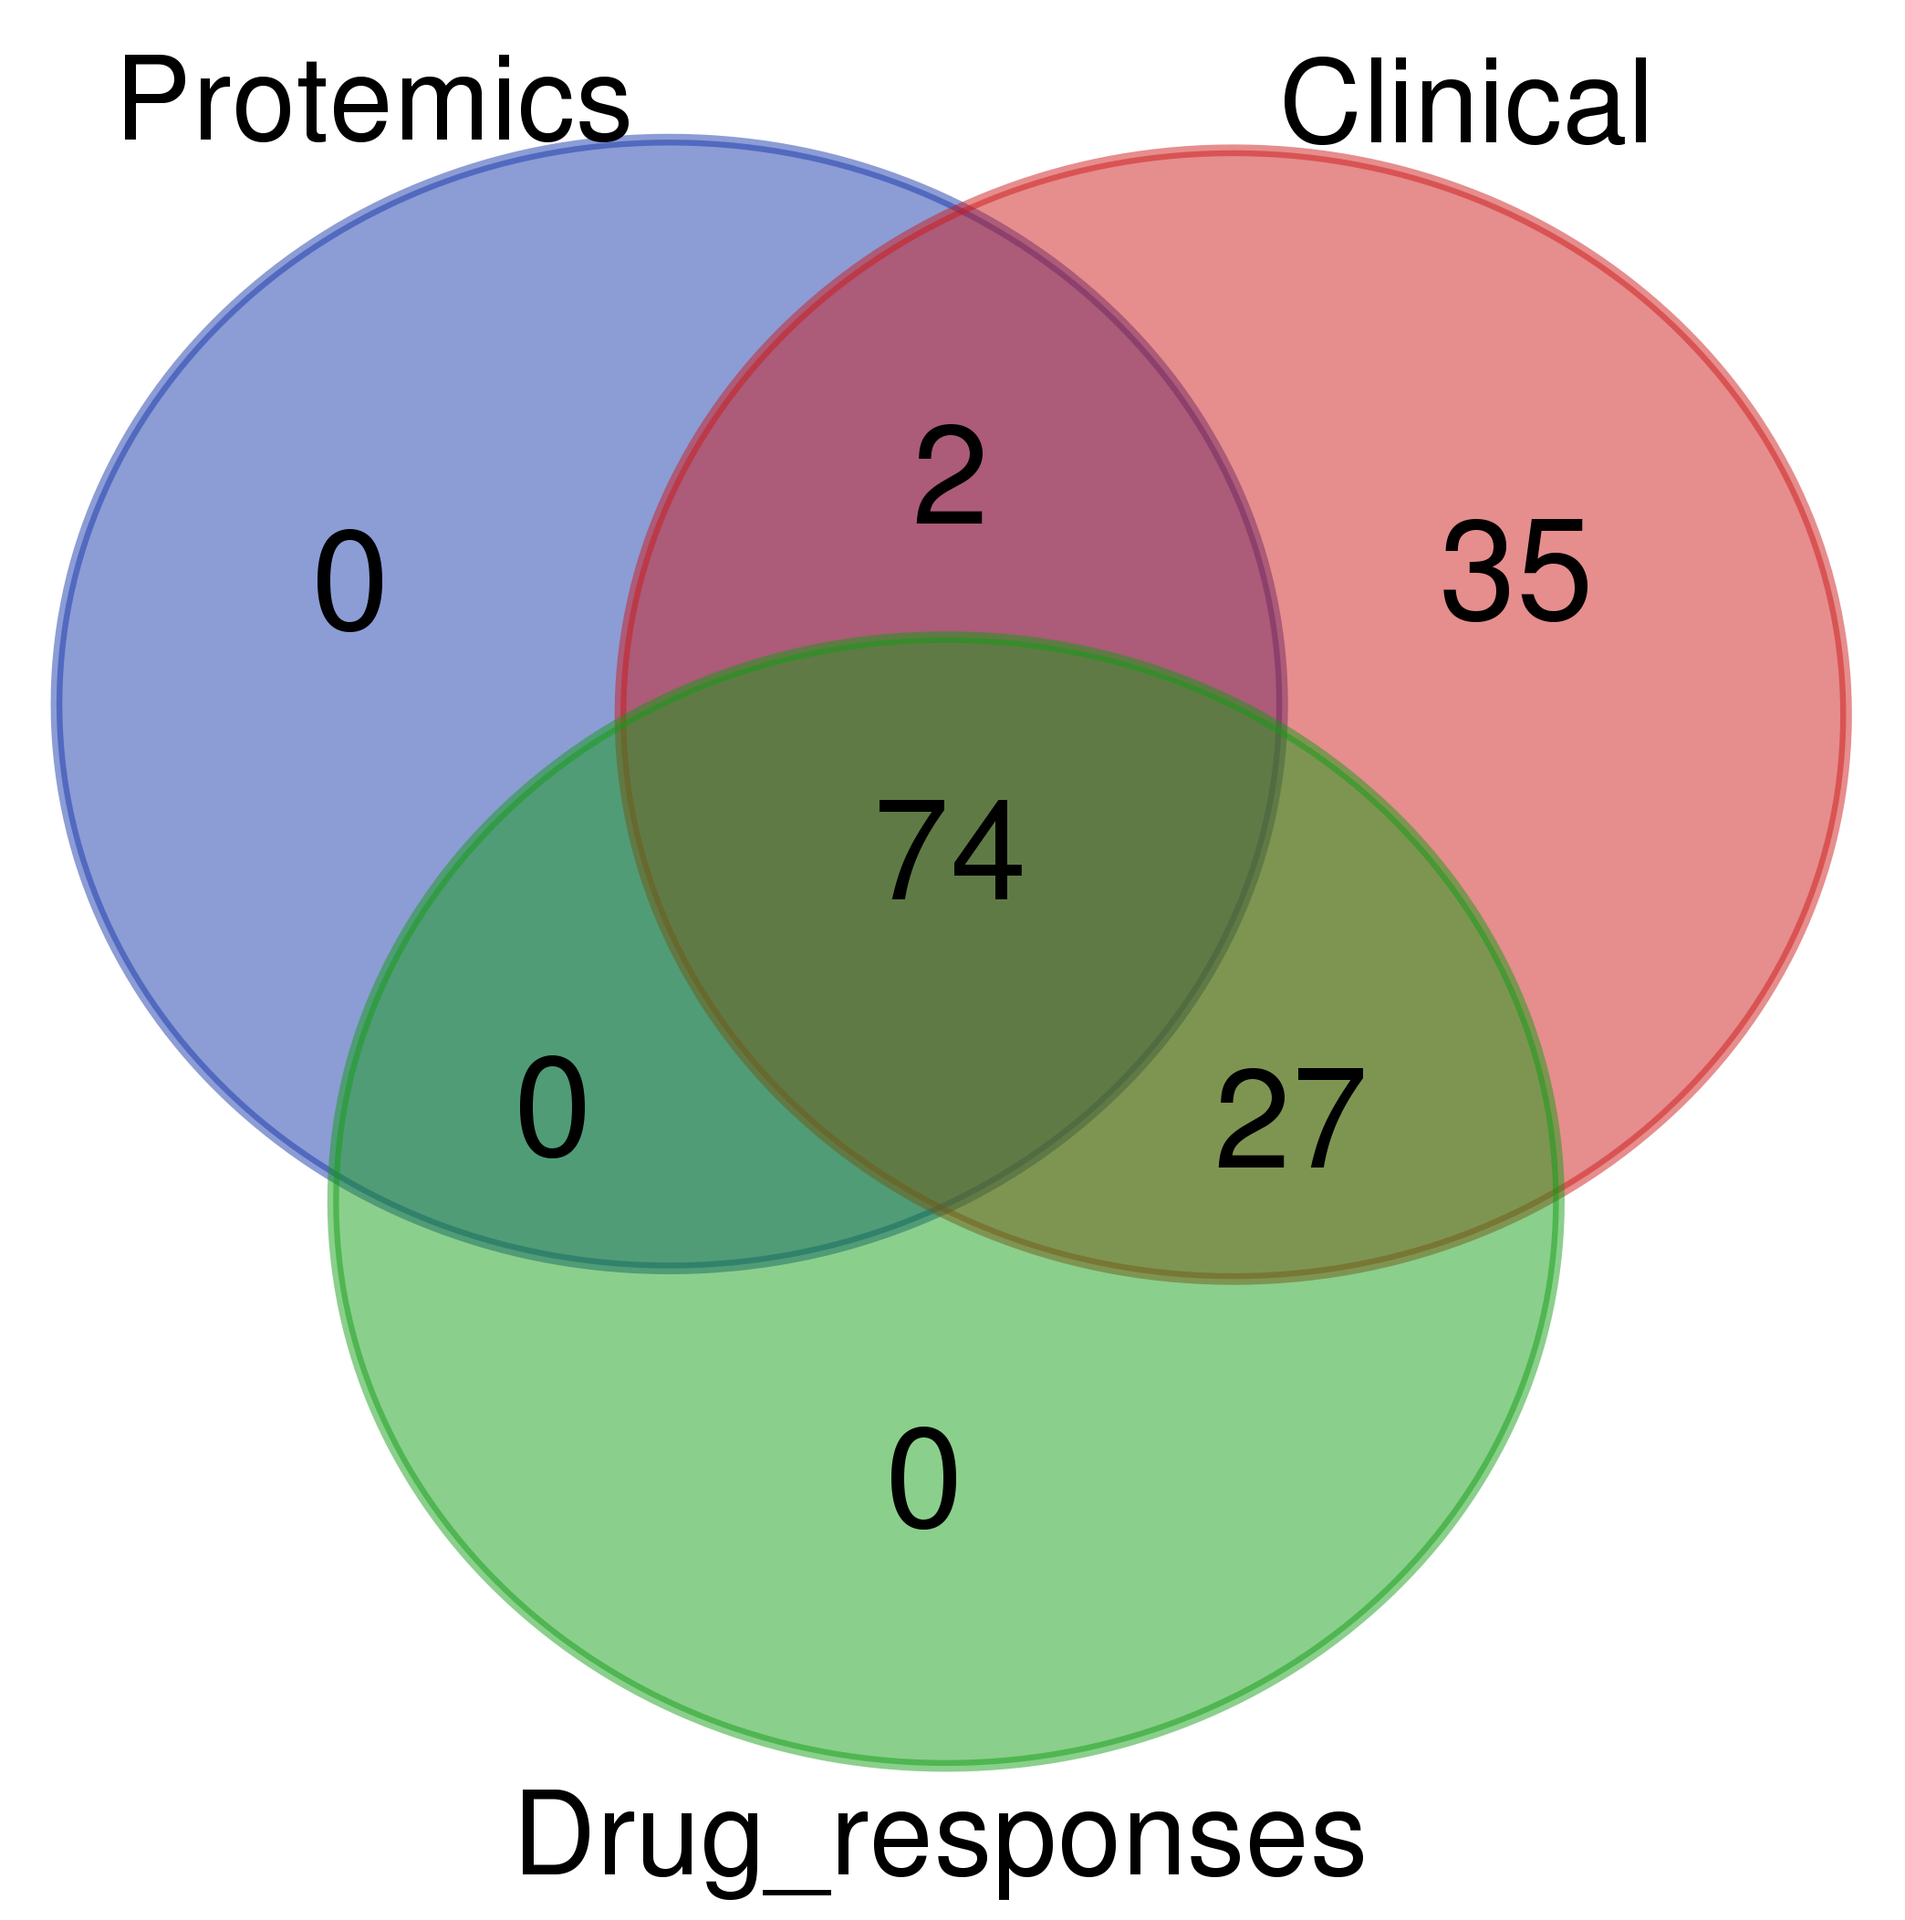
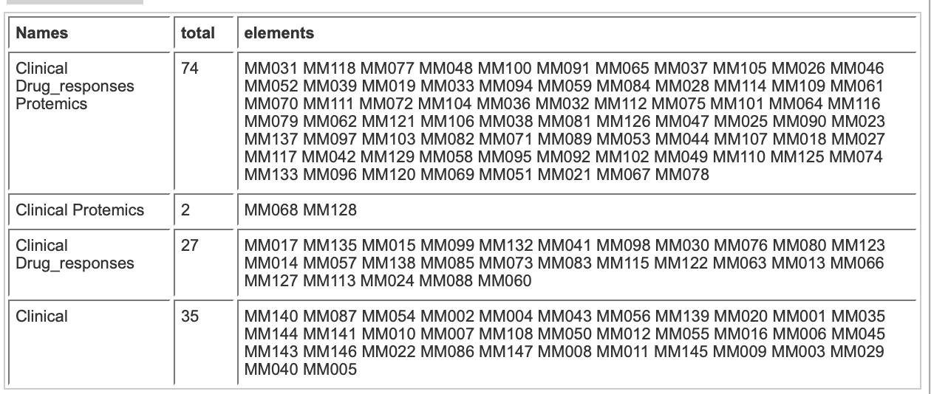

Slide 6
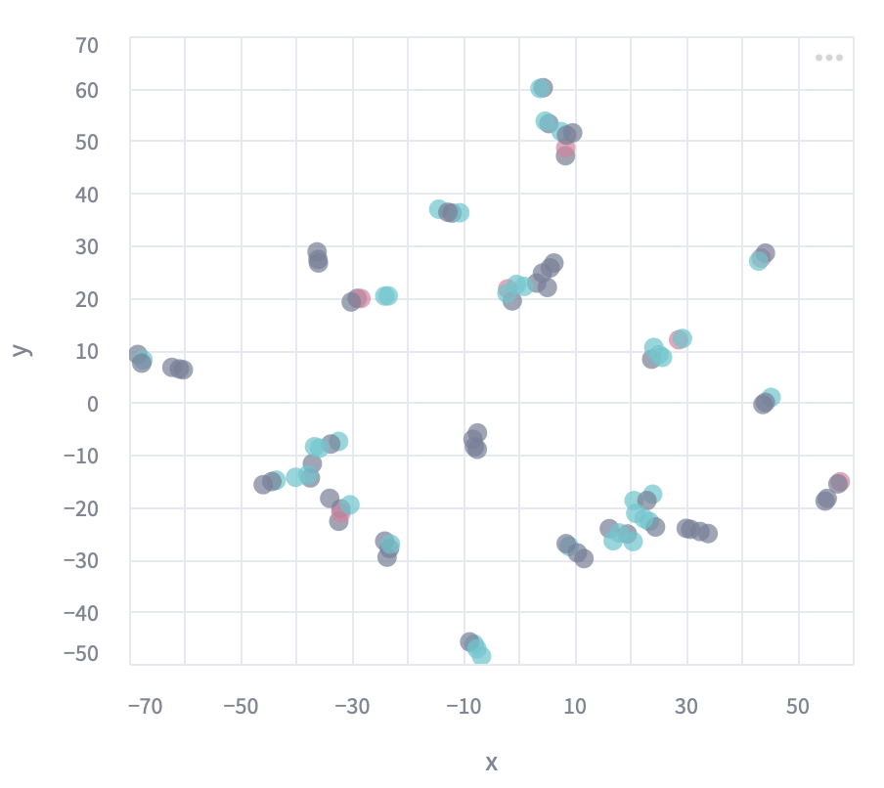
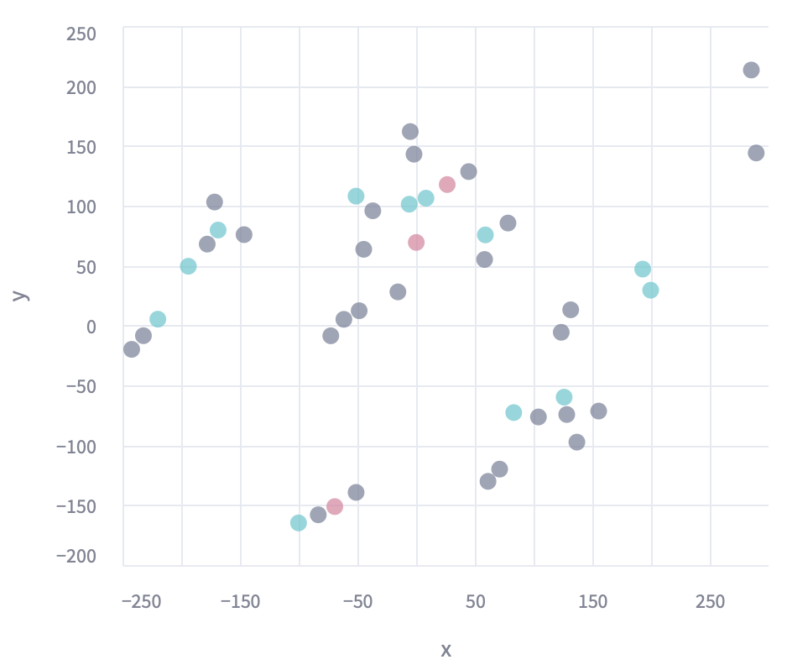
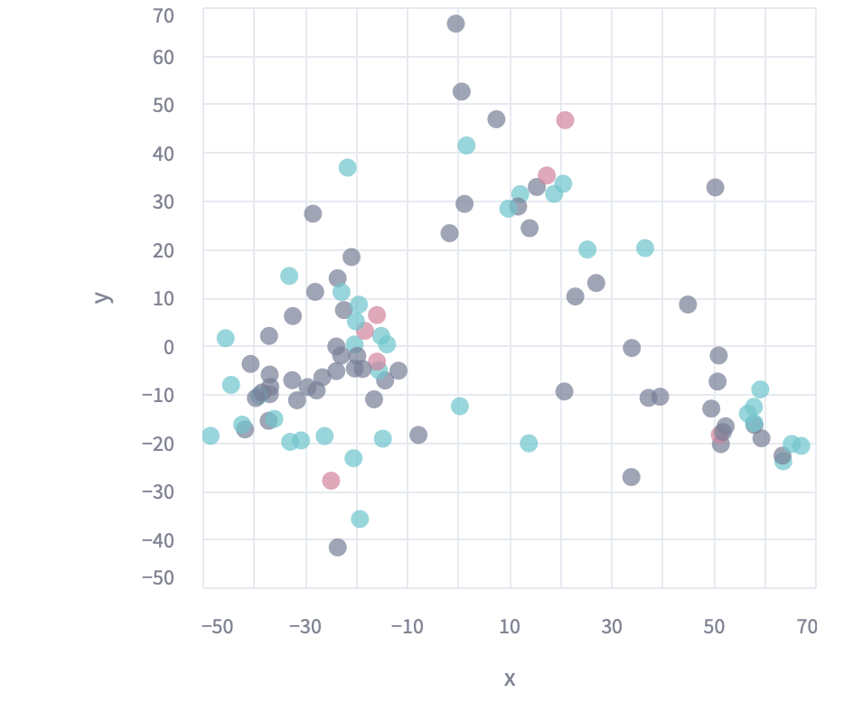
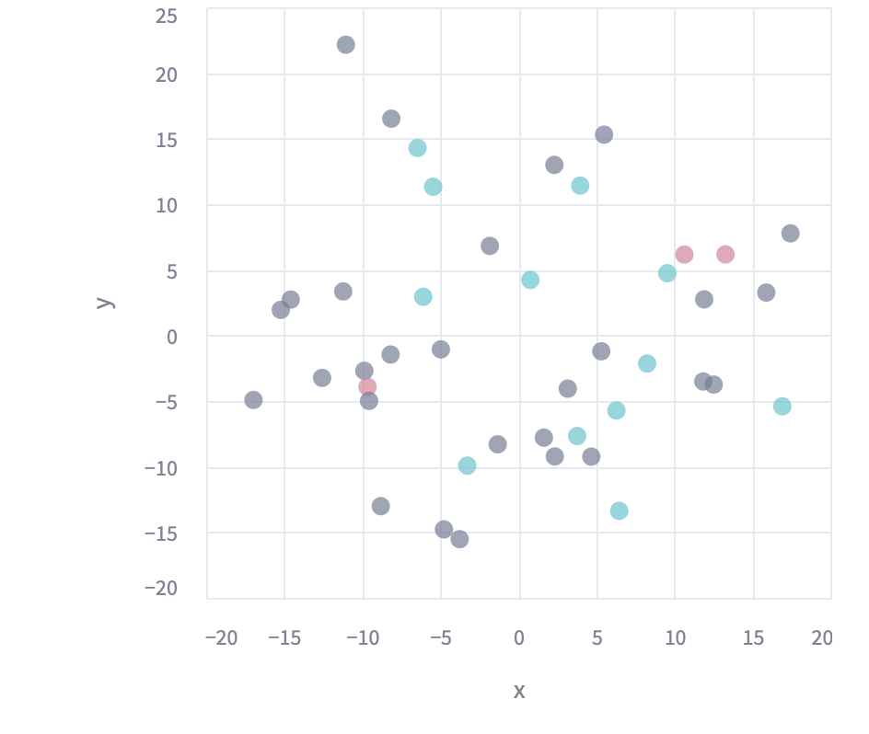
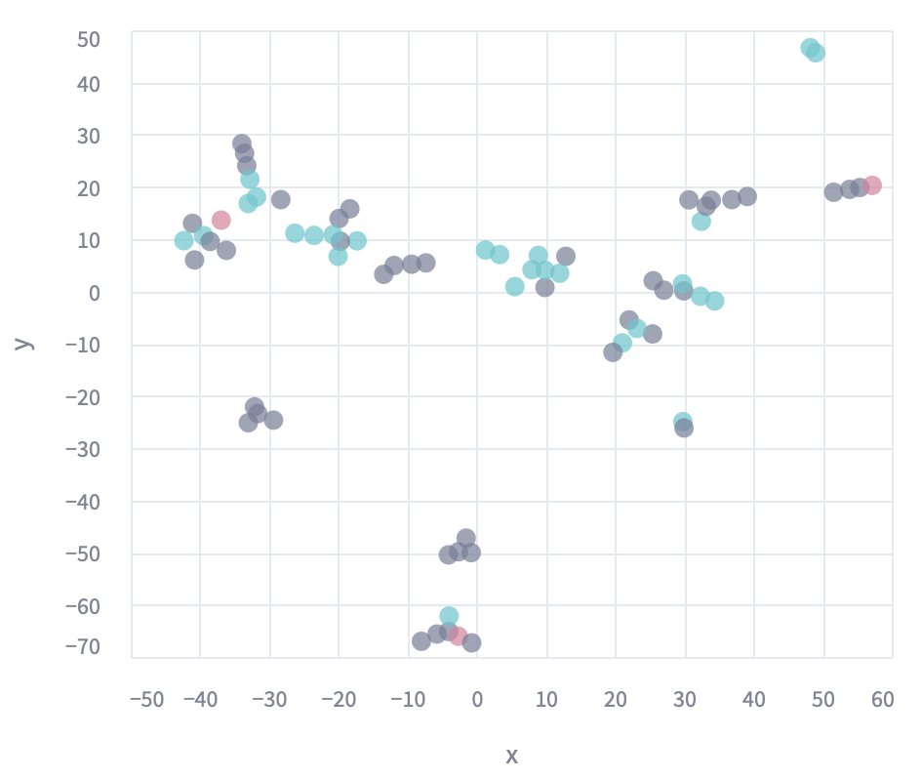
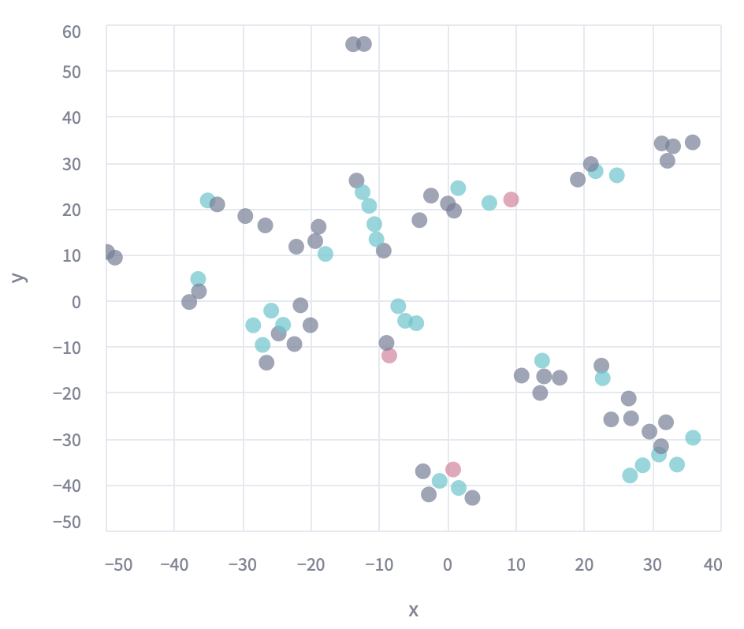
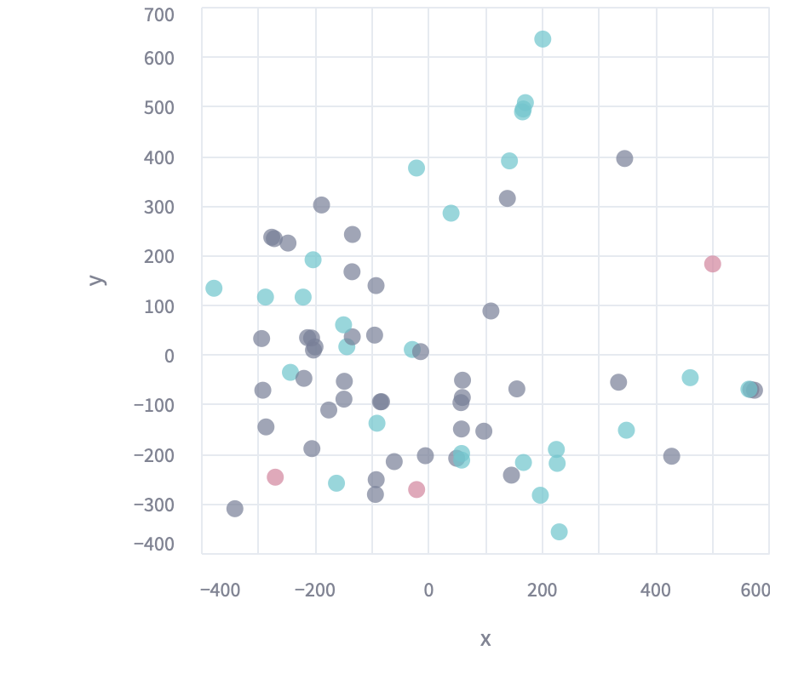
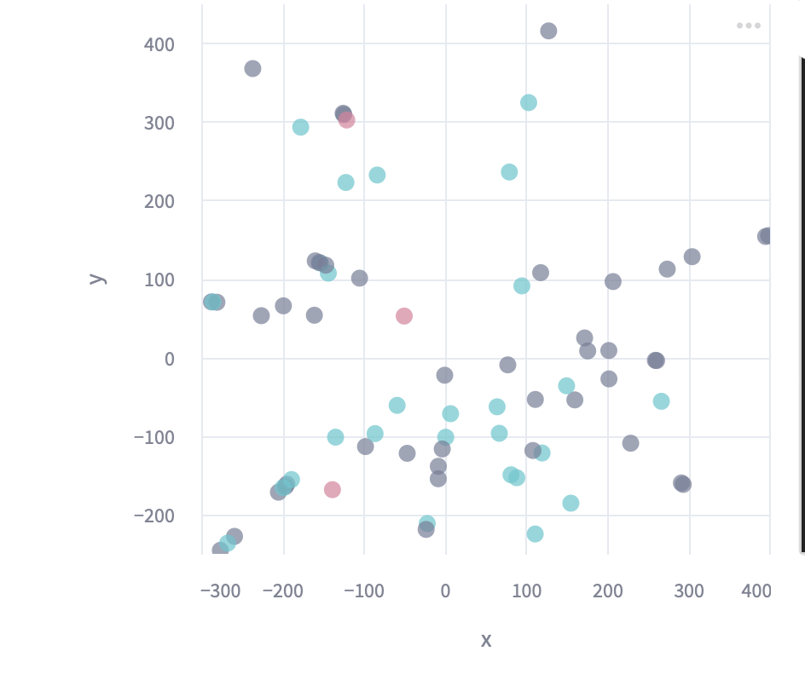
Stratify patients using unsupervised DR approaches and map drug responses
Dexamethasone
TSNE: t-distributed Stochastic Neighbor Embedding)
Clinical | Cytokine
Proteomics_CD138 | Proteomics_myeloma_cells
ISOMAP
Clinical | Cytokine
Proteomics_CD138 | Proteomics_myeloma_cells

Slide 7
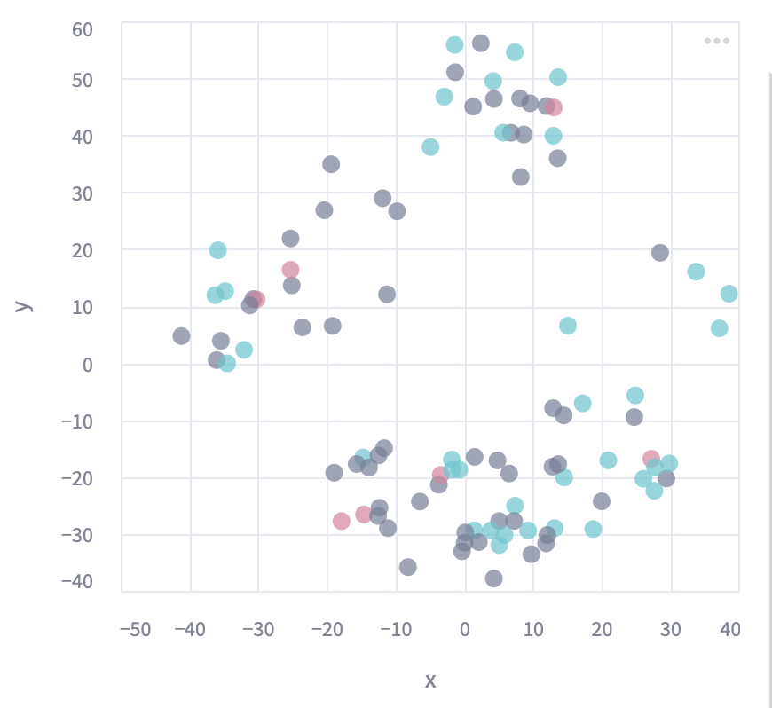
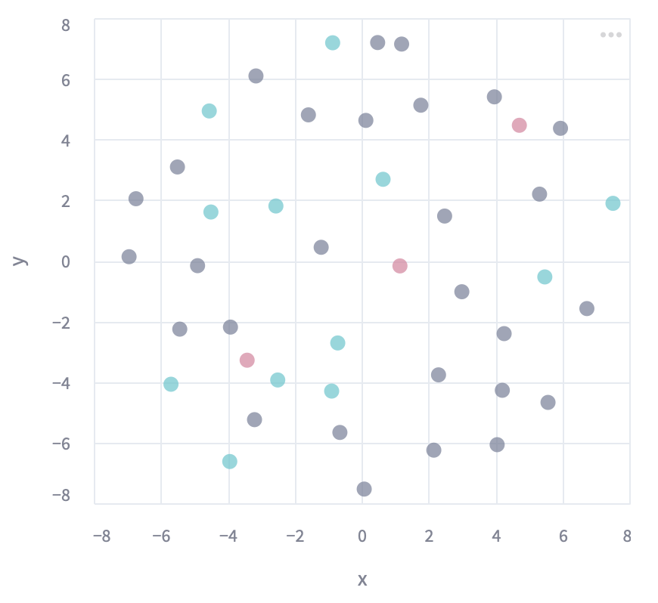
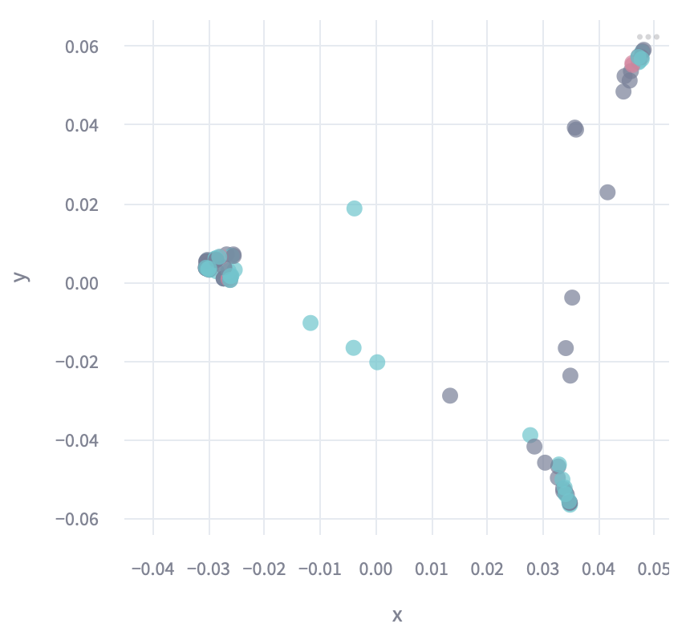
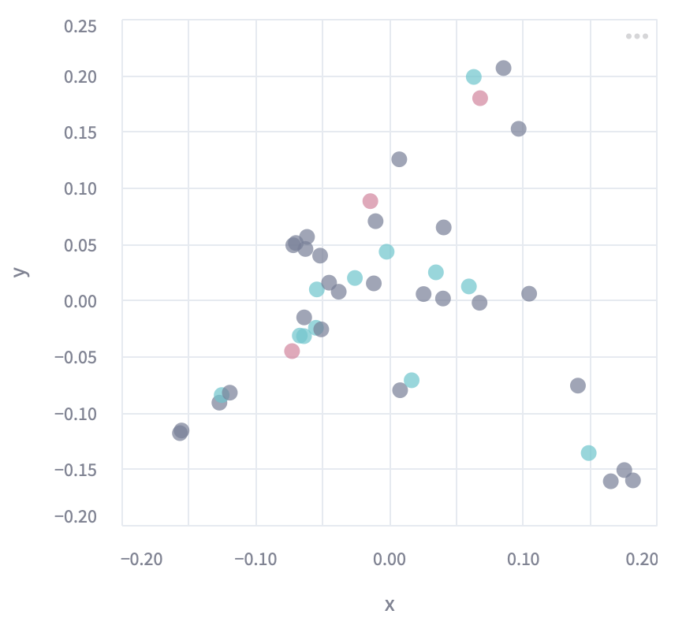
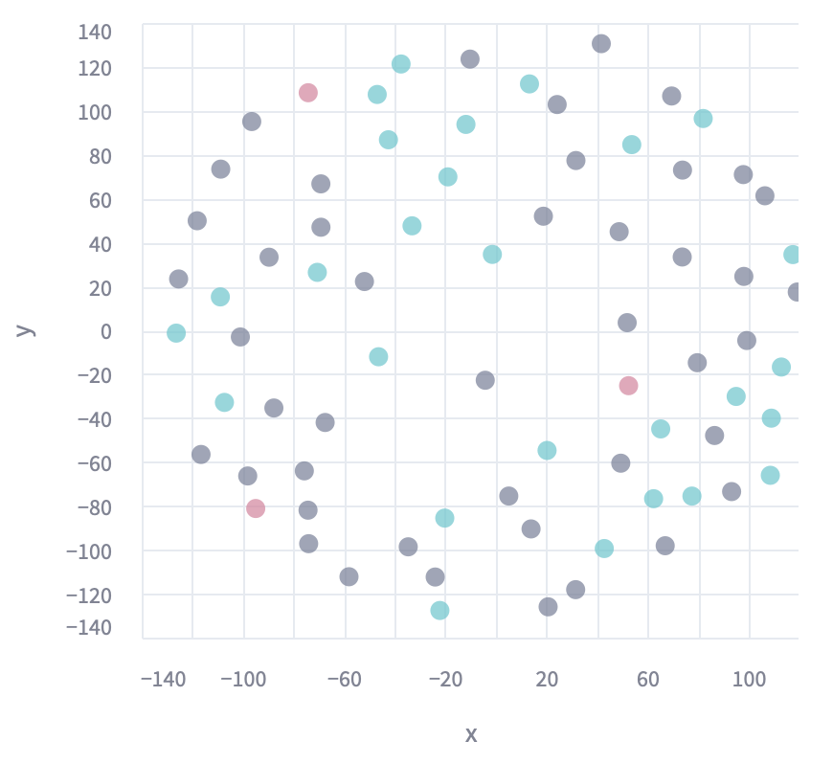
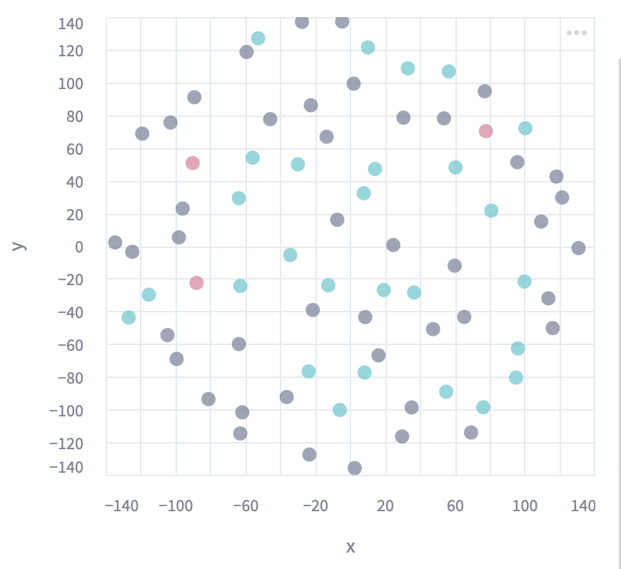
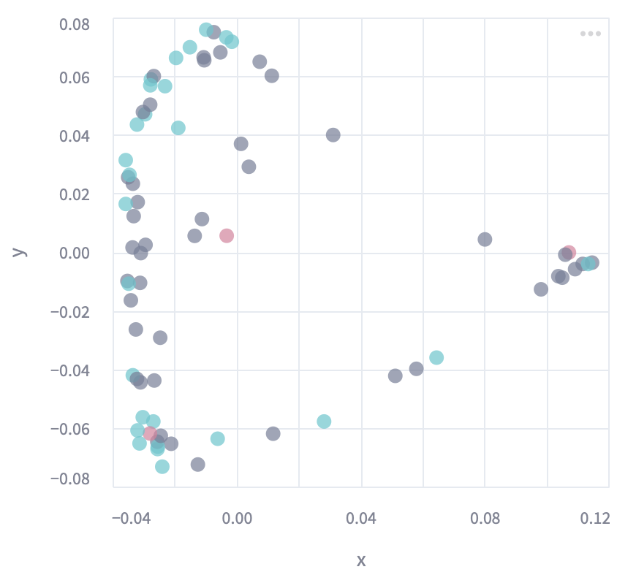
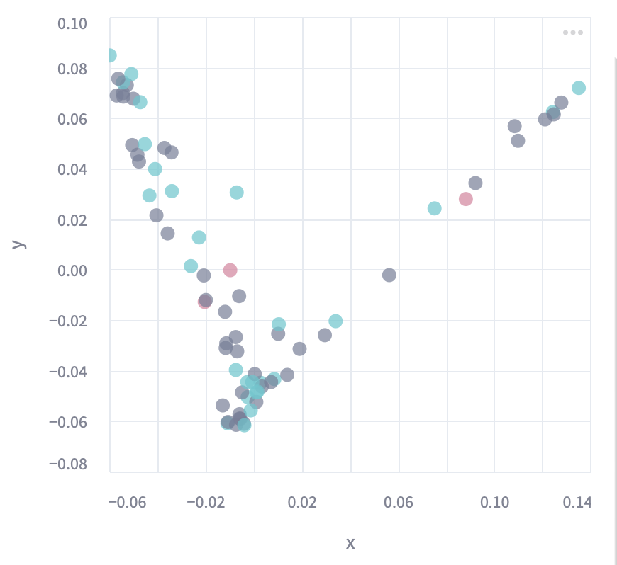
Stratify patients using unsupervised DR approaches and map drug responses
Dexamethasone
MDS: Multidimensional Scaling
Clinical | Cytokine
Proteomics_CD138 | Proteomics_myeloma_cells
SE: Spectral Embedding
Clinical | Cytokine
Proteomics_CD138 | Proteomics_myeloma_cells

Slide 8
Conclusion
Unsupervised approaches cannot learn features that could stratify patients based on drug responses

Slide 9
Other possibilities:
Graph based methods?
Motivation:
Patients with same disease are expected to share some molecular/clinical features.
However, some patients respond differently even on the same treatment
Can we capture this information with patient similarity networks?

Slide 10
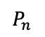
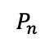
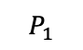
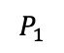
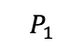
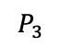
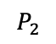
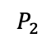
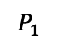
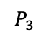
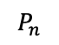
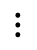
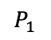
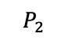
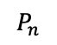
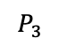
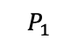
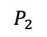
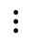
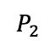
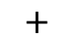
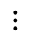
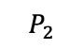
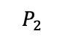
Current Baseline Workflow
3
Patient Embeddings
Graph Representation Learning
$$P_{1}$$
2
$$P_{2}$$
1
$$P_{3}$$
Patient Similarity Network
$$P_{1}$$
Predictions
Multi-Modal Data
$$⋮$$
4
$$P_{1}$$
$$P_{n}$$
$$P_{2}$$
$$P_{1}$$
$$P_{1}$$
Classification
$$P_{3}$$
$$P_{2}$$
$$+$$
$$P_{3}$$
Mutual Information
$$P_{1}$$
$$P_{2}$$
$$P_{2}$$
$$⋮$$
$$⋮$$
$$P_{2}$$
$$P_{1}$$
$$P_{2}$$
$$P_{n}$$
$$P_{n}$$
$$P_{3}$$
$$⋮$$
Graph Convolution Networks
Graph Attention Networks
$$P_{n}$$
Drug Responses

Slide 11


Results
4 Modalities
Proteomics_CD138
Proteomics_myeloma
Clinical
Cytokines
Patient Similarity Network

Slide 12




Results
Train: 80%
Test:20%
Mean and Std over 10 runs, random shuffling
4 Modalities

Slide 13


Results
4 Modalities
Proteomics_CD138
Proteomics_myeloma
Cytokines

Slide 15


Results
CD138, myeloma, cytokines
Proteomics_CD138
Clinical
Cytokines

Slide 17


Results
4 Modalities
Proteomics_myeloma
Clinical
Cytokines

Slide 19


Results
4 Modalities
Proteomics_CD138
Proteomics_myeloma
Clinical

Slide 21


Results
CD138 + myeloma
Proteomics_myeloma
Proteomics_CD138

Slide 22




Results
Train: 80%
Test:20%
Mean and Std over 10 runs, random shuffling
CD138 + myeloma

Slide 23


Results
Cytokines + Clinical
Cytokines
Clinical

Slide 24




Results
Cytokines + Clinical

Slide 25


Results
Cytokines + CD138
Proteomics_CD138
Cytokines

Slide 27


Results
Cytokines + myeloma
Proteomics_myeloma
Cytokines

Slide 29


Results
Clinical + CD138
Proteomics_CD138
Clinical

Slide 31


Results
Clinical + myeloma
Proteomics_myeloma
Clinical

Slide 33


Results
CD138
Proteomics_CD138

Slide 35


Results
Myeloma
Proteomics_myeloma

Slide 37


Results
Cytokines
Cytokines

Slide 38




Results
Cytokines

Slide 39


Results
Clinical
Clinical

Slide 40

Results
Clinical

Slide 41

PatStrat: Current Hour Status of the project
Total hours CLAMP+ PatStrat = 1200h (perhaps, 400h + 800h or, 600h + 600h )
Hours booked, Karolina’s hours??
I have overbooked hours for PatStrat,
*I need to dedicate myself to ChronoType as soon as IP agreement is settled*

Slide 42
My contribution until now:
March: worked 2 weeks
data preprocessing, unsupervised
GNN implementation and streamlit app
Master thesis co-supervision, one/two weekly one hour meetings since April 2024
I have overbooked hours for PatStrat,
*I need to dedicate myself to ChronoType as soon as IP agreement is settled*

Slide 44

























Concept
Patient Features
3
2
Patient Embeddings
$$P_{1}$$
Biomarkers
$$P_{2}$$
$$P_{1}$$
Predictions
1
$$P_{3}$$
$$P_{2}$$
Joint-SVD
GraphSAGE
$$P_{3}$$
Multi-Modal Data
$$⋮$$
[…]
$$⋮$$
$$P_{1}$$
$$P_{n}$$
[…]
[…]
$$P_{2}$$
[…]
$$P_{n}$$
6
$$P_{3}$$
$$P_{1}$$
[…]
$$P_{2}$$
5
[…]
[…]
$$P_{3}$$
[…]
$$+$$
Regression
model
$$⋮$$
$$⋮$$
A
B
C
$$P_{1}$$
Sample Neighborhood
Aggregate feature information from neighbors
Predict graph context and label using aggregated information
$$P_{2}$$
$$P_{n}$$
$$P_{n}$$
SNF
$$P_{3}$$
Positive Response
4
$$⋮$$
No Effect
$$P_{n}$$
Patient Similarity Network
Adverse Effects
Drug Responses
SVD: Singular Value Decomposition
SNF: Similarity Network Fusion

Slide 45
Concept

Slide 47
PatStrat: Patient Stratification Framework for Predicting Treatment Responses

Slide 48
Question to address
Drug response prediction
Bio-markers for patient-stratification
Added value of Multi-modal data integration

Slide 49
Possible Approach
Train and Test on ETHZ MM dataset treatment line 0
Train and Test on ETHZ MM dataset, treatment line 0, validation with another MM cohort
Train and Test on ETHZ MM dataset treatment line 0, validation on treatment line 1,2,3 datasets

Slide 50













2. Joint-SVD
$$K$$
$$K$$
Modality embeddings
Patients
$$P_{1}$$
$$P_{1}$$
$$P_{2}$$
$$K$$
$$K$$
$$P_{2}$$
$$P_{3}$$
$$P_{3}$$
$$⋮$$
$$⋮$$
$$P_{n}$$
$$P_{n}$$
Modalities
Patient embeddings
https://www.nature.com/articles/s41467-020-20430-7
https://academic.oup.com/bioinformatics/article/38/24/5383/6793849
Notes:
https://www.nature.com/articles/s41467-020-20430-7
https://academic.oup.com/bioinformatics/article/38/24/5383/6793849

Slide 51



3. Biological Interpretation
Potential Biomarkers
Modality embeddings
$$K$$
Pathway and Biological processes

Slide 52

4. Similarity Network Fusion
https://www.nature.com/articles/nmeth.2810
Notes:
https://www.nature.com/articles/nmeth.2810

Slide 53
5. GraphSAGE
[…]
[…]
[…]
[…]
[…]
[…]
[…]
[…]
A
B
C
Sample Neighborhood
Aggregate feature information from neighbors
Predict graph context and label using aggregated information
https://arxiv.org/pdf/1706.02216
Notes:
https://arxiv.org/pdf/1706.02216

Slide 54

6. Predictions with regression model

Slide 55
Strategies for outreach
Conference poster
Poster and a conference paper

Slide 57
To-dos
Upgrade the code base
Testing for additional datasets
(at-least 2 more, pharmacoscopy, IC50, etc.)
2. Dataset from Tim’s paper
3. AML datasets: https://depmap.org/portal/ ?
Compiling results
Paper drafting
Paper review

Slide 58
To-dos
Upgrade the code base and test it for MM dataset (Surabhi)
Code review & Documentation (Surabhi /Jonas/Lucas)
Testing for additional datasets (Francesca/Lucas/Jonas)
(at-least 2 more, pharmacoscopy, IC50, etc.)
2. Dataset from Tim’s paper
3. AML datasets: https://depmap.org/portal/ ?
Compiling results (Surabhi)
Paper drafting (Surabhi)
Paper review (Tim & Carine)

Slide 63
PatStrat: Patient Statification Framework

Slide 64










Multilayer Graph Embedding model
$$P_{1}$$
Similarity
Network
$$P_{2}$$
$$P_{3}$$
$$⋮$$
$$P_{n}$$
$$P_{1}$$
$$P_{2}$$
$$P_{3}$$
$$⋮$$
SNF
$$P_{n}$$
$$P_{1}$$
$$P_{2}$$
$$P_{3}$$
$$P_{1}$$
$$P_{2}$$
$$⋮$$
$$P_{3}$$
$$⋮$$
$$P_{n}$$
Drug responses
$$P_{n}$$
Multi-modal data
Relevant Features
Similarity
Networks

